Slide 1
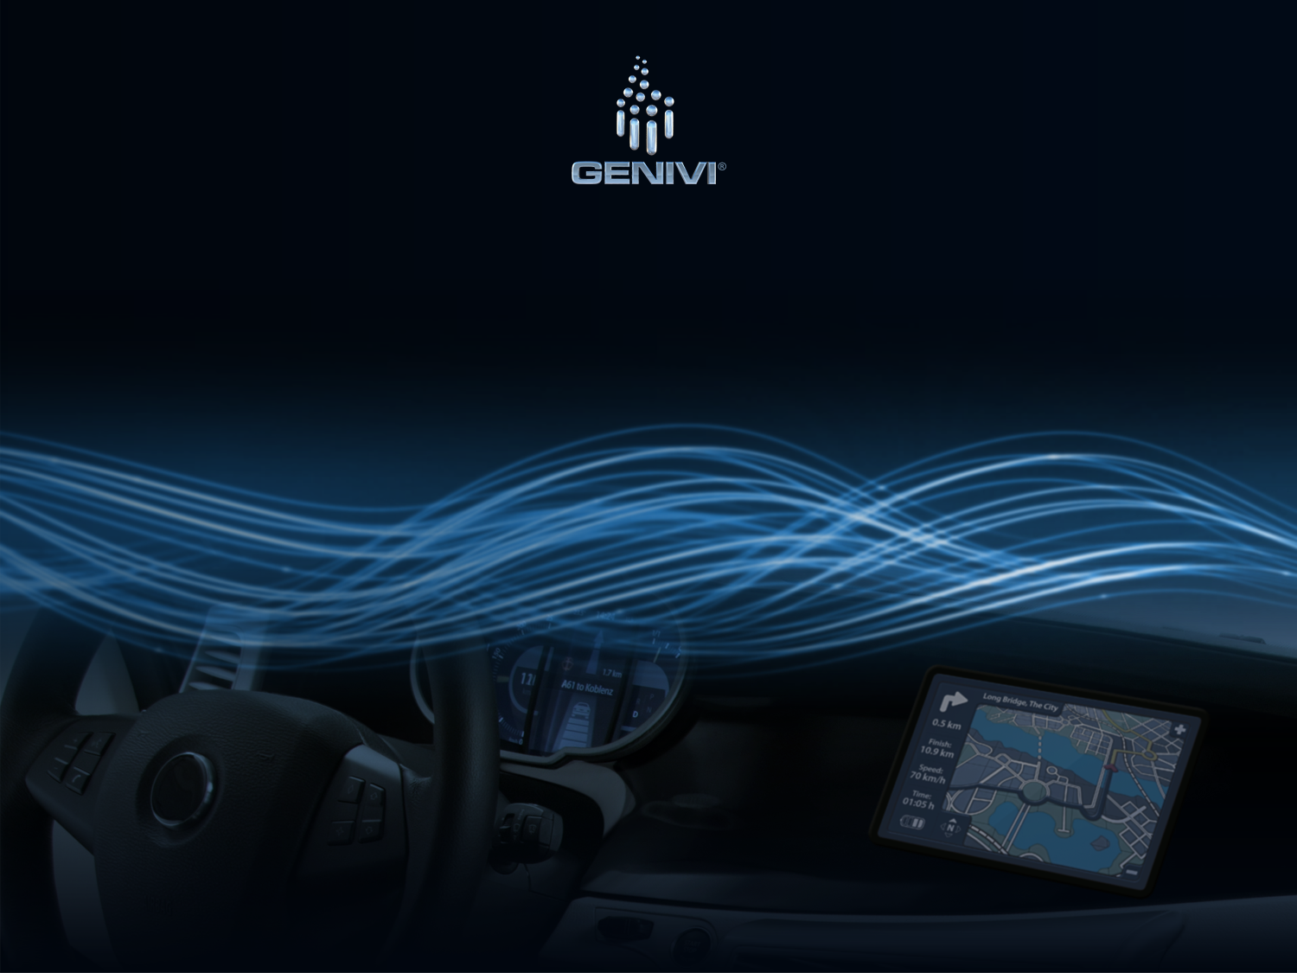
IPC CommonAPI C++
23.4.2013 - 15:00
Developers and Architects
Manfred Bathelt
EG-SI Topic Lead IPC
BMW Group

Slide 2
Overview
Motivation
Introduction to IPC CommonAPI C++
(small) Example
Performance
Roadmap
Conclusion
Prospects

Slide 3
D-Bus Usage – Status Quo
specification provides well defined basic datatypes and a wire-format.
Libdbus is a powerful reference implementation.
intended to provide all required functions for D-Bus IPC
NOT indended as an all days developer API!
High effort for manual usage
Some significant performance issues
most people use D-Bus through a language binding.
see http://www.freedesktop.org/wiki/Software/DBusBindings
Optimal adaption to desired language and framework
All language bindings can communicate well between each other if applying data types provided by D-Bus specification only.

Slide 4
Problems
Not all components use D-Bus at all.
Some components should intentionally NOT use D-Bus, but e.g. vehicle network (dependend on project setup).
Migration of components to a different communication layer is difficult, expensive and hard to keep in sync with upstream.

Slide 5
IPC CommonAPI C++ Objectives
Decouple IPC from application code
enable communication layer agnostic application implementation. Required to create application building blocks.
simplify IPC migration for optimization or integration needs.
designed as C++ (ISO/IEC 14882:2011) language binding gcc >= 4.6 recommended (gcc 4.4 & 4.5 require workarounds).
Use Franca IDL for interface design
simple OSS IDL and tools with little overhead, used in Genivi.
agnostic of communication middleware technology.

Slide 6

IPC CommonAPI C++ Architecture
Application Code
middleware agnostic - remains the same
generated code
CommonAPI C++
IPC CommonAPI C++
runtime library
middleware dependent
generated code
CommonAPI C++ D-Bus
IPC CommonAPI C++
D-Bus runtime library
generated code
Middleware X
Middleware X
runtime library
D-Bus communication infrastructure
Middleware X communication infrastructure

Slide 7
IPC CommonAPI C++ Project Status
Public project infrastructure launched: http://projects.genivi.org/commonapi/
API Specification created together with Harman available
published runtime components and Eclipse based code generator tools as open source (MPL-2.0)
Accepted for compliance 4.0 (Foton)
Maintained by BMW development team

Slide 8
Component Development Status (1)
IPC CommonAPI C++ Runtime
Specific P2 component in GENIVI compliance 4.0 (Foton)
Library, designed using C++ (ISO/IEC 14882:2011) gcc >= 4.6 recommended (gcc 4.4 and 4.5 require some workarounds).
IPC CommonAPI C++ Tools
Eclipse based code generator for middleware independent code
Generates C++ header files according to Franca IDL specification
Development tool: not part of compliance

Slide 9
Component Development Status (2)
IPC CommonAPI C++ D-Bus Runtime
Specific P2 component in GENIVI compliance 4.0 (Foton)
Library, required by generated D-Bus implementation code
Requires libdbus serialization patch
Supports both vanilla libdbus and AF_BUS as an option
IPC CommonAPI C++ D-Bus Tools
Eclipse based code generator for middleware dependent code
Generates D-Bus implementation compatible to IPC CommonAPI C++
Development tool: not part of compliance

Slide 10
Franca IDL Example
package my.example
interface MyInterface {
version {major 1 minor 0}
method addEntry {
in {
String surname
String name
}
}
broadcast entryAdded {
out {
String surname
String name
}
}
}

Slide 11
CommonAPI Example - Client
void addContact(std::shared_ptr<my::example::MyInterfaceProxy<> >& proxy) {
std::string surname = "John";
std::string name = "Doe";
CommonAPI::CallStatus status;
std::cout << "Calling MyInterface.addEntry( " << surname << ", " << name << " ) ...\n";
proxy->addEntry(surname, name, status);
}
CommonAPI::SubscriptionStatus entryAddedCallback(std::string surname, std::string name) {
std::cout << "entryAddedCallback( " << surname << ", " << name << " )\n";
return CommonAPI::SubscriptionStatus::RETAIN;
}
int main(void) {
std::shared_ptr<CommonAPI::Runtime> runtime = CommonAPI::Runtime::load();
std::shared_ptr<CommonAPI::Factory> factory = runtime->createFactory();
auto proxy = factory->buildProxy<my::example::MyInterfaceProxy> ("local:my.example.MyInterface:my.example.Instance1");
proxy->getEntryAddedEvent().subscribe(&entryAddedCallback);
while (true) {
addContact(proxy); // do something
sleep(1);
} }

Slide 12
CommonAPI Example - Service
class MyInterfaceIndividualStub : public my::example::MyInterfaceStubDefault {
public:
MyInterfaceIndividualStub() {}
virtual ~MyInterfaceIndividualStub() {}
virtual void addEntry(std::string surname, std::string name) {
std::cout << "Received call to addEntry( " << surname << ", " << name << " )\n";
fireEntryAddedEvent(surname, name);
}};
int main(void) {
std::shared_ptr<CommonAPI::Runtime> runtime = CommonAPI::Runtime::load(); std::shared_ptr<CommonAPI::Factory> factory = runtime->createFactory();
auto myStub = std::make_shared<MyInterfaceIndividualStub>();
factory->registerService(myStub, "local:my.example.MyInterface:my.example.Instance1");
while(true) {
sleep(1);
}}

Slide 13
IPC CommonAPI C++ Benchmark
Benchmark created for IPC CommonAPI C++
commonapi-echo
Existing benchmark for libdbus
dbus-ping
Pandaboard/OMAP4
YOCTO 1.3 based plattform (kernel 3.4)
Vanilla D-Bus 1.4.16 (no AF_Bus) with message validation enabled

Slide 14
Performance
Overhead <20%

Slide 15
Known Limitations as of April 2013
IPC CommonAPI C++:
Broadcasts: the keyword selective for Franca IDL broadcasts is currently not supported. Discussion on this topic is ongoing.
Contract: Franca IDL Contracts are not supported.
Arrays: Implicit definition of arrays as specified by Franca IDL is currently not supported. Typedef can be used as workaround.
gcc: compilation requires C++11 features introduced with gcc version 4.6. All necessary language features are provided since gcc version 4.4.2. though.
Loading of middleware libraries: Full dynamic loading of middleware libraries (i.e. without explicitly linking them either statically or dynamically to the executable) is currently not supported.
IPC CommonAPI C++ D-Bus:
Polymorphic data types not handled properly in implementation yet.

Slide 16
Feature Roadmap Gemini
Remove Known Limitations
Support Franca´s selective broadcast
Mainloop integration
Polymorphic data types
Dynamic loading of middleware libraries
improved API for service stubs (optional)
Eliminate copies of passed argument data
Improved code generator UI
Better and descriptive error messages
Command line interface for code generators

Slide 17
Multiple Middleware Support
Application Code
Middleware agnostic - remains the same
generated code
CommonAPI C++
IPC CommonAPI C++
runtime library
Middleware dependent
Middleware dependent
Middleware dependent
generated code
CommonAPI C++ D-Bus
IPC CommonAPI C++
D-Bus runtime library
generated code
Middleware X
Middleware X
runtime library
generated code
Middleware Y
Middleware Y
runtime library
D-Bus
Middleware X
Middleware Y

Slide 18
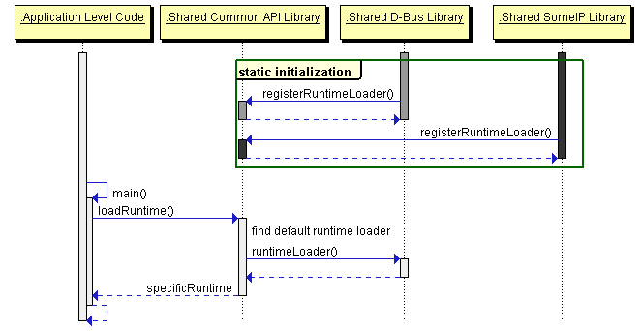
Loading Middleware
Runtime loaders of linked middleware libraries register themselves at startup.
The middleware library that is initialized first will be the default backend.
Specific middleware library can be selected by name optionally.

Slide 19
Prospects: New kdbus Approach (1)
new „kdbus“ IPC implementation driven by Lennart Poettering, Kay Sievers and Greg Kroah-Hartmann.
Mission:
Generic, efficient IPC infrastructure solution.
not restricted to D-Bus, other IPC like binder api shall be supported as well.
Kernel based to ensure security isolation.

Slide 20
Prospects: New kdbus Approach (2)
systemd bus: userland D-Bus implementation driven by Lennart Poettering and Kay Sievers as first step towards kdbus:
Early experimental implementation available since March 20 as part of systemd development (only D-Bus yet).
New API, but can talk to vanilla D-Bus
Shall also support kdbus kernel feature developed by GregKH in the future
Early kdbus kernel implementation available at https://github.com/gregkh/kdbus/commits/master

Slide 21
Prospects: New kdbus Approach (3)
Early benchmarks of systemd´s D-Bus client library on Pandaboard:
dbus-ping-systemd and dbus-test-service-systemd
Measuring empty messages (no payload) to compare framework performance rather than marshalling performance
Comparing to dbus-ping using AF-BUS
libdbus, afbus, clone: 2074
systemd: 7407
Factor 3,6 Improvement!

Slide 22
Links
GENIVI IPC CommonAPI C++ homepage: http://projects.genivi.org/commonapi/
GENIVI IPC CommonAPI specification: https://collab.genivi.org/wiki/display/genivi/SysInfraEGCppCommonAPISpecification
Franca homepage: http://code.google.com/a/eclipselabs.org/p/franca/

Slide 23
BACKUP

Slide 24
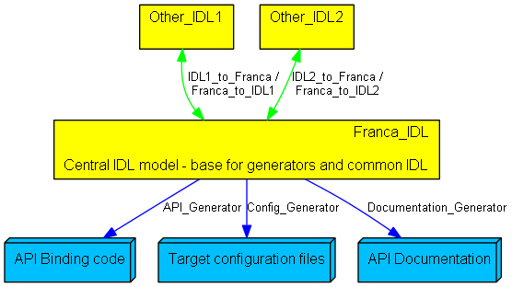
Define Interfaces using Franca IDL
Franca IDL had been designed as pivot model to specify abstract interfaces and deployment
perfectly usable Eclipse based editor available
Supports transformations to other IDLs, e.g. D-Bus XML, FIBEX, etc
Franca is able to store all required information for code generation in deployment models
e.g. FIBEX
e.g. D-Bus XML

Slide 25
Transport Layer Migration – Multiple Connectors
Application 1
Application 2
D-Bus
Custom IPC / DSI
Multiple connectors increase implementation effort and complexity of applications!

Slide 26
Transport Layer Migration - Gateway
Application 1
Application 2
CPU!
D-Bus
Gateway
Custom IPC / DSI
Gateways increase latency and CPU load significantly!

